Slide 1
Market Risk and Analysis -By Kanupriya Mittal
Café Chain Analysis

Slide 2
INDEX
Objective
Executive and Key Insights from Exploratory Data Analysis
Analysis of Different Times of a Day
Analysis of Different Days of a Week
Menu Delisting
Price Variation Analysis
Monthly Trend Analysis
Mix menu analysis and Combo offer
Recommendations

Slide 3
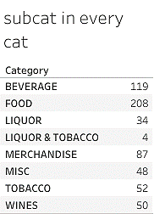
They say Variety is the spice of life. So, let’s look at how many varieties each category is offering!
Sub-Categories

Slide 4
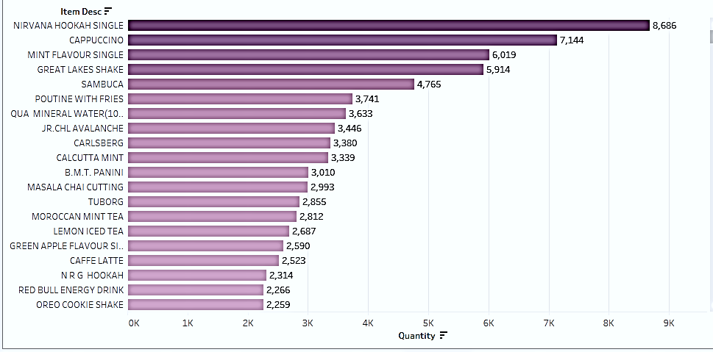
Top Items assorted by the Quantity Here, the items are assimilated with respect to the Quantity in which they were brought through 1st April,2010- 28th Mar,2011. we infer that the top 5 purchased items /most popular items are: Nirvana Hookah Single, Cappuccino, Mint Flavor Single, Great Lakes Shake, Sambuca

Slide 5
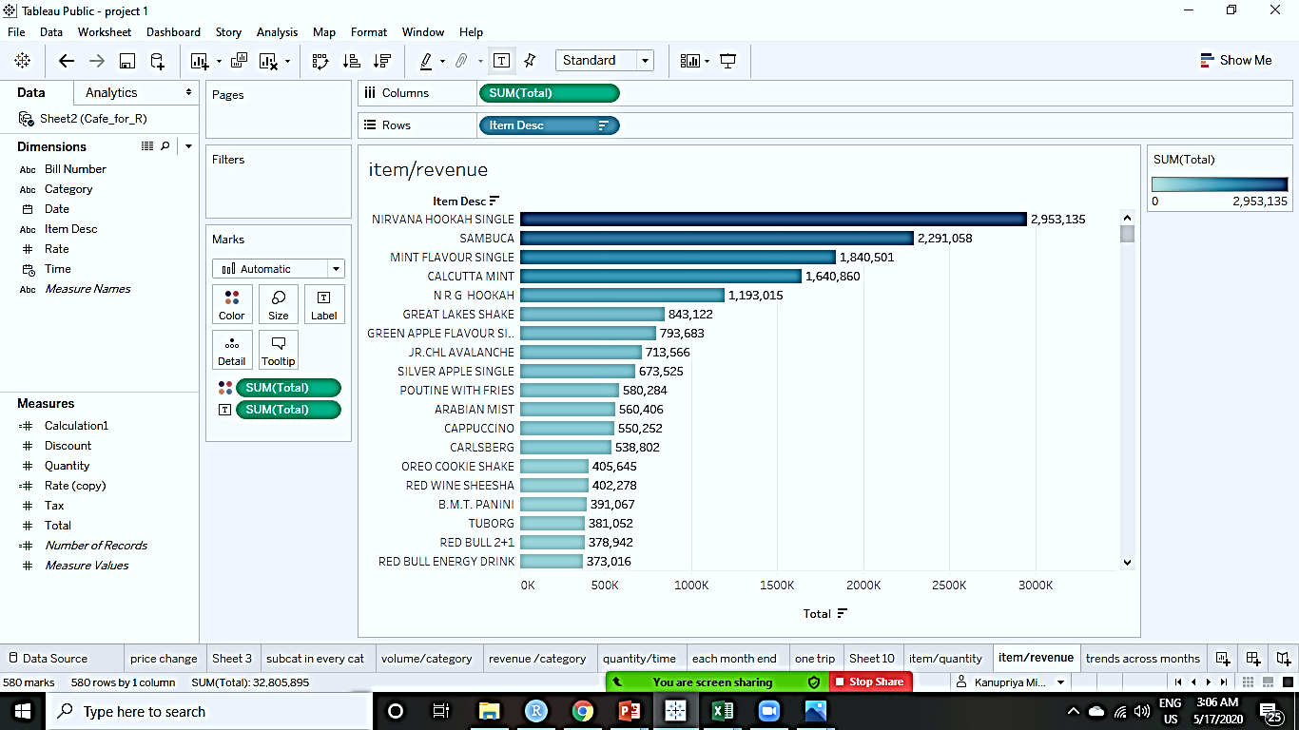
Top Items assorted by Total Sales Here, the items are assimilated with respect to the Quantity in which they were brought through 1st April,2010-28th Mar,2011. we infer that the top 5 purchased items /most popular items are: Nirvana Hookah Single, Sambuca, Mint Flavor Single, Calcutta Mint, N R G Hookah

Slide 6
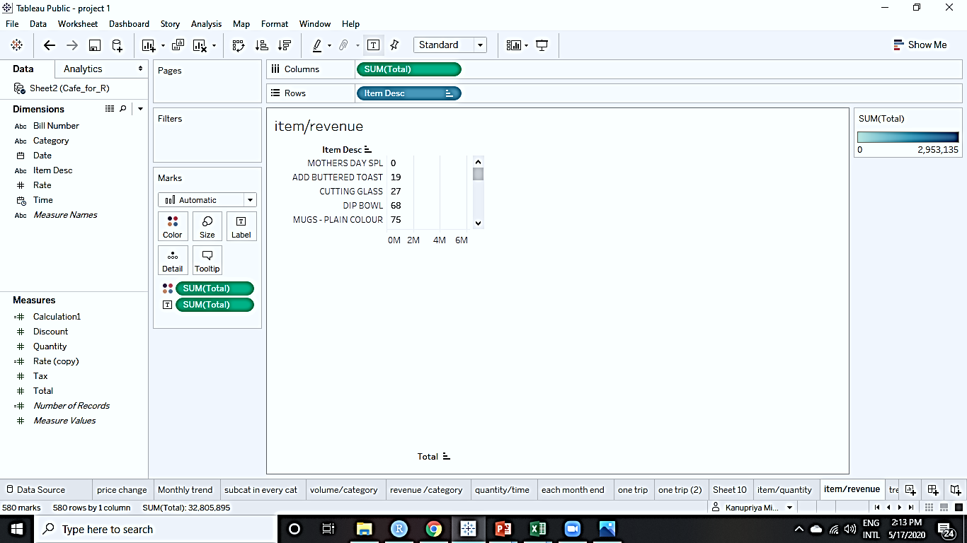
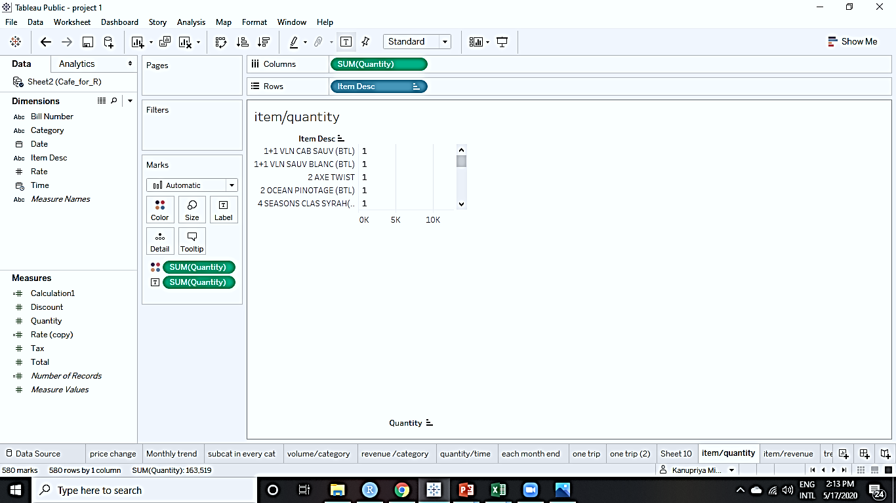
Analysis of Least bought Items Below are the least valuable items in the Café both in terms of the Volume purchased and the revenue generated from them.
Revenue
Quantity

Slide 7
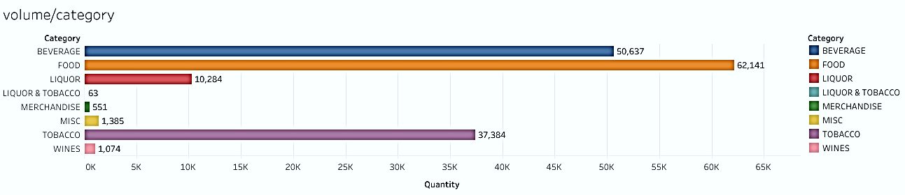
Quantitative Distribution of Categories Food > Beverage > Tobacco. These 3 categories are the most frequently bought.

Slide 8
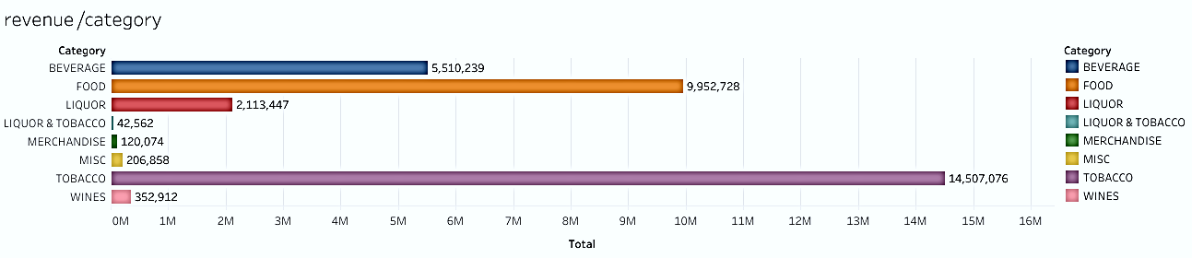
Sales distribution of Categories Food > Beverage > Tobacco. These 3 categories are the most frequently bought.

Slide 9
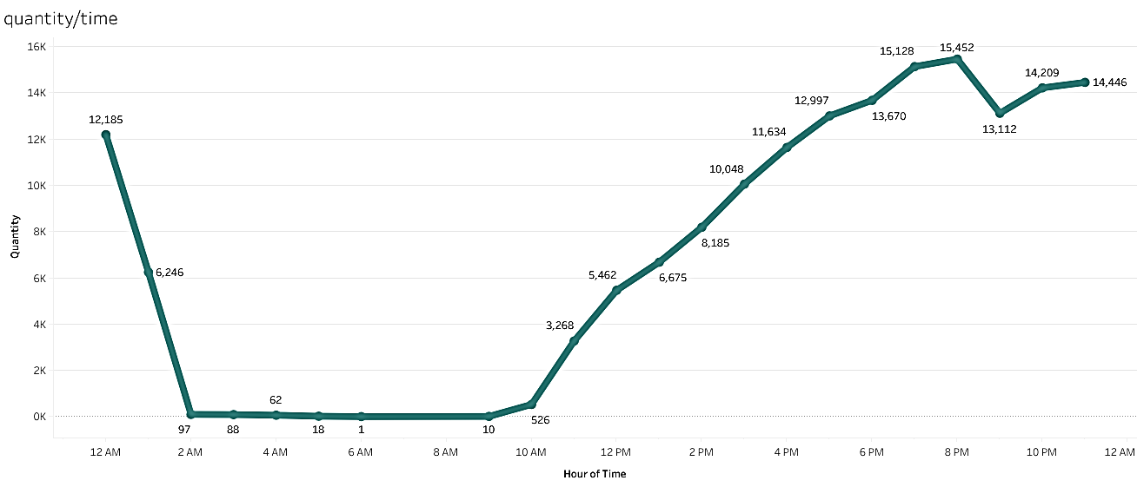
Hourly Distribution of Quantities in a Day
Rush Hours: 6pm till 12am(highest sales)
Recommended Business hours: 11 am till 1 am
Recommended closing hours: 2 am till 10 am(negligible sales)

Slide 10
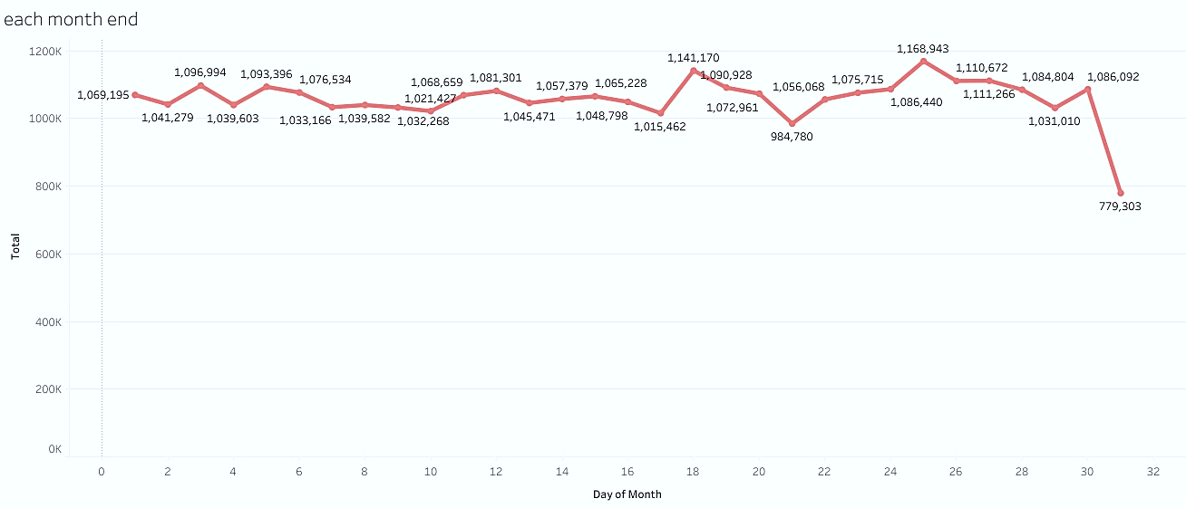
Daily Distribution of Total Revenue over a Month The sales each day throughout the month have a zig zag distribution with a constant variance except for the Last Day of the month, when we observe a sudden drop in the sales of the café.

Slide 11
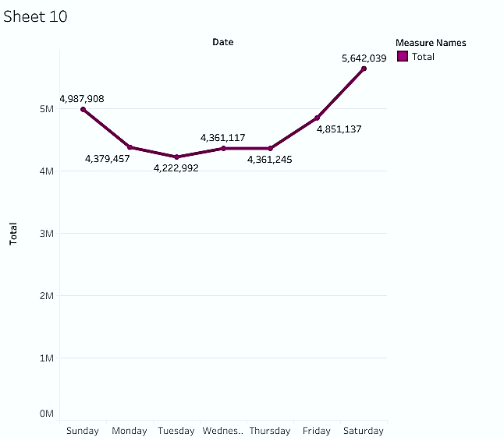
Trends of the Revenue generated each day of the week On scrutiny, we infer that Saturdays are the largest sale catchers. A positive trend of sales can be observed as the weekend starts and this trend declines and reaches stability along with the commencement of weekdays. Top 2 days for revenue to the Café are Saturday followed by Sunday.

Slide 12
Exploratory data analysis- Annual data at a glance
Total revenue INR 3,28,05,895
Total quantity sold 163519 units
Average revenue/month INR 27,33,825
Average revenue/week INR 6,30,883
Average revenue/day INR 89,879
Best day on 31st Dec 2010, with 834 menu items served & INR 249995 as revenue

Slide 13
Delist Items Analysis
There are some items which add almost nothing to the revenue. These items are bought rarely in a year and the sales from these aren’t significant either. So, we will reduce our inventory of these Items so our investments are reduced on non-profitable items. The items which are to be Delisted are currently a liability for the Café .
We have displayed a distribution of the Least Bought items from each category along with the total Revenue that they generated for the Café for over a year in the following slides…

Slide 14
In perspective of Revenue to the Café, DELIST ITEMS 1/2 Beverage Category: 5 Items are to be removed from the menu Food Category : 19 Items are to be removed from the menu Wines Category: 17 Items are to be removed from the menu Tobacco Category : 19 Items are to be removed from the menu
BEVERAGE | Total Sales
2 AXE TWIST | 173.25
MIXED FLAVOUR SINGLE | 297
DECAFFINATE COFFEE FRAPPE | 92.81
MOCAFE HOT CHOCOLATE(SF) | 80.44
PEACH BULL | 185.63
FOOD | Total Sales
CAPONATA | 185.63
ADD BUTTERED TOAST | 18.56
SUNNY SIDEUP + BEVERAGE | 245.02
WAFFLES + BEVERAGE | 367.53
2 MUFFINS + BEVERAGE | 367.53
WINES | Total Sales
B1G1 4SEASON CLAS SAUV(GLS) | 252
MANDALA VALLEY CHENIN BLANC(GL | 220.5
B1G1 4SEASON CLAS SYRAH(GLS) | 441
TOBACCO | Total Sales
CLASSIC REGULAR | 93.6
GOLD FLAKE ULTRA LIGHTS(20) | 87.6
INDIA KINGS OCEAN BLUE | 109.8
CLASSIC MENTHOL RUSH | 199.92
GOLD FLAKE LIGHTS-BIG | 262.8
BENSON & HEGDES GOLD BLUE | 329.4
CLASSIC ULTRA MILD | 386.4
CLASSIC MENTHOL | 362.4

Slide 15
In perspective of Revenue to the Café, DELIST ITEMS 2/2 Miscellaneous Category: 17 Items are to be removed from the menu Merchandise Category : 19 Items are to be removed from the menu
MISC | Total Sales
M & M SHAKE | 222.75
MANGO FLAVOUR SINGLE | 297
ROMA TOMATO & JALAPENO CROQUE | 154.69
MEXICAN CHILLY CREPES | 204.19
GNOCCHI CON POMMODORO | 185.63
POLLO PELOTA CON TAMATE SALSA | 235.13
JAPANESE YAKITORI WRAP | 185.63
RASPBERRY LITE SHAKE | 142.31
RED BULL 2+1 | 309.38
MEDITER RANEAN PANINO | 259.88
ORANGE ARRABIATA | 371.26
GREEK GYROS CRUSTINI | 358.88
PHILADELPHIA CREAM CHEESECAKE | 383.62
NUTELLA CREPES | 321.76
HOTDOG WRAP | 371.26
ADD GROUND MEAT | 111.39
ADD CHICKEN BACON | 148.52
MERCHANDISE | Total Sales
BEACH GREEN | 294.75
GREAT LAKES MUG SINGLE | 159.75
CH TIN SMALL | 179.55
GUERILLA COOL | 294.75
COUNTRY LEMONADE GLASS(HANSA) | 168.75
KITSCH BLUE | 294.75
DIP BOWL | 67.5
KITSCH PINK | 294.75
KONKAN STRIPE | 294.75
DHARMATEA LIGHT HOLDER | 280.13
MUGS - PLAIN COLOUR | 75.38
ASH TRAYS | 168.75
ROCK THE BOAT TEA LIGHT HOLDER | 249.75
ETCHED LEAF TLIGHT HOLDER | 280.13
SHAKE GLASS | 281.25
CHAIRMAN COOL | 294.75
CH WRAPPING PAPER | 90
CUTTING GLASS | 27
CH CRICKET NOTEBOOK | 300.3

Slide 16
Price Variation Analysis There are a plethora of Items in our data where there are changes in the prices and thereby inducing a change in the sales of those Items. Price change effect – There is mixed response by customers to hike in prices. Tobacco, Liquor have turned in favor of the café.

Slide 17
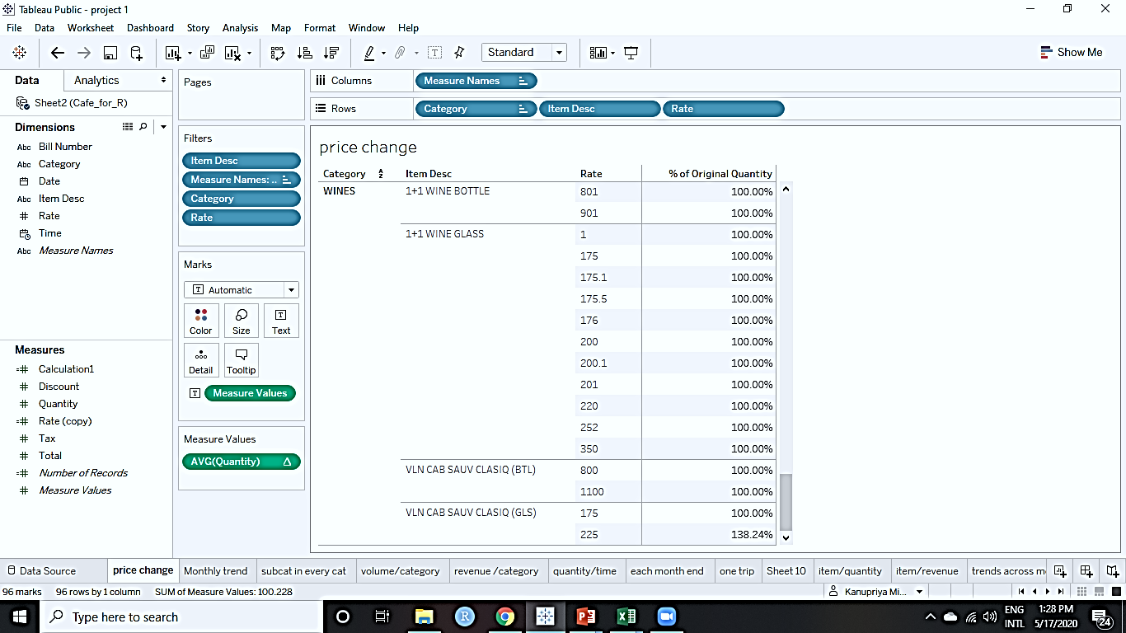
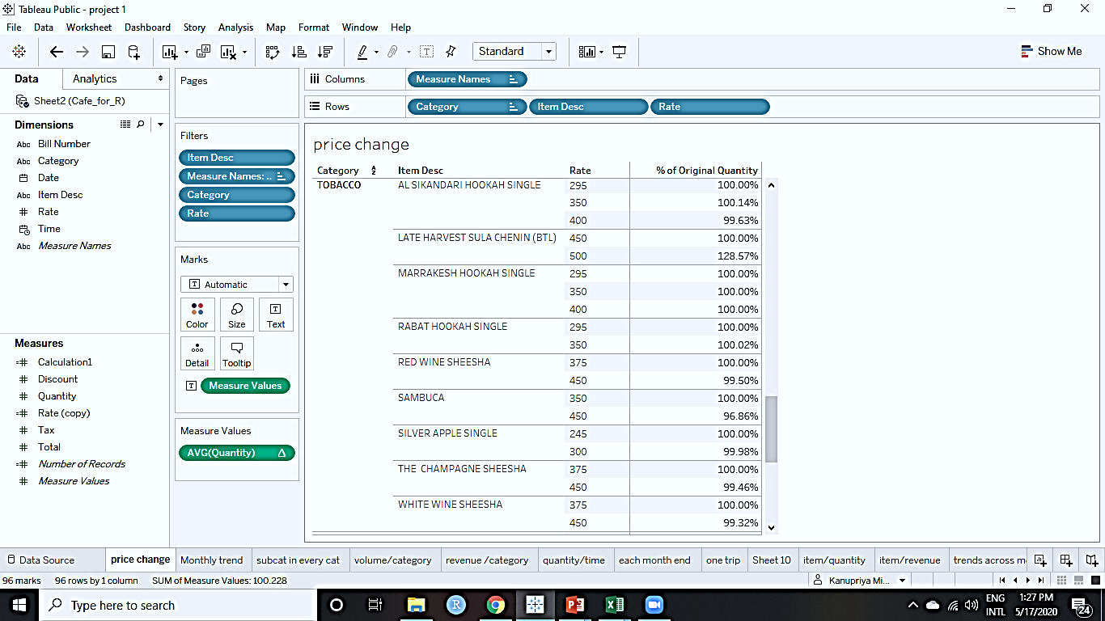
Tobacco: A mammoth price hike is observed in the prices of tobacco but that has not deterred the consumers from buying it. This is as sad as it is true.
Wines: In these cases there has been a drastic increment in the prices of wines, but the sales aren’t reduced by price inflation, in fact for Cab Sauv Clasiq, the sales increased after the price hike.

Slide 18
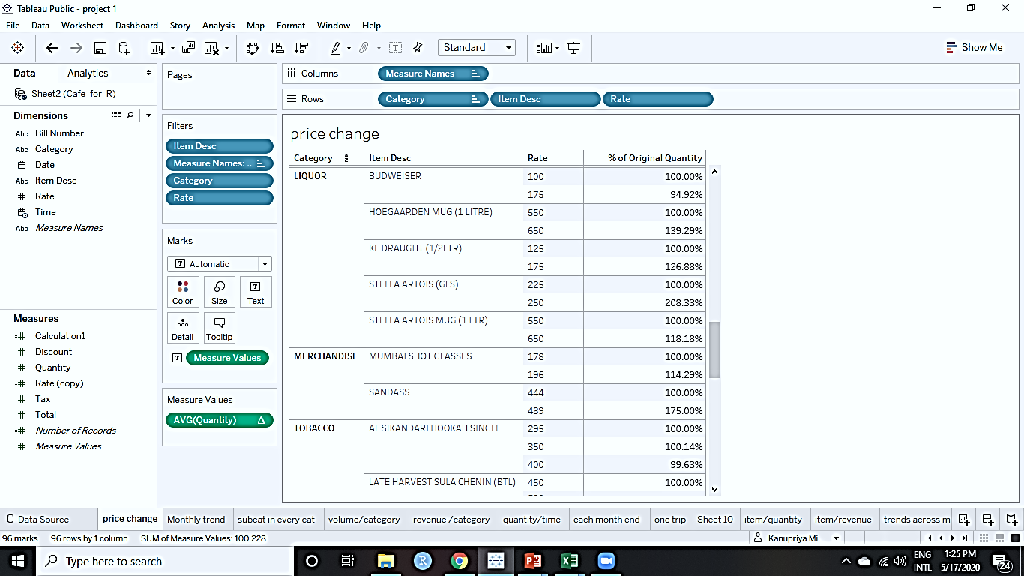
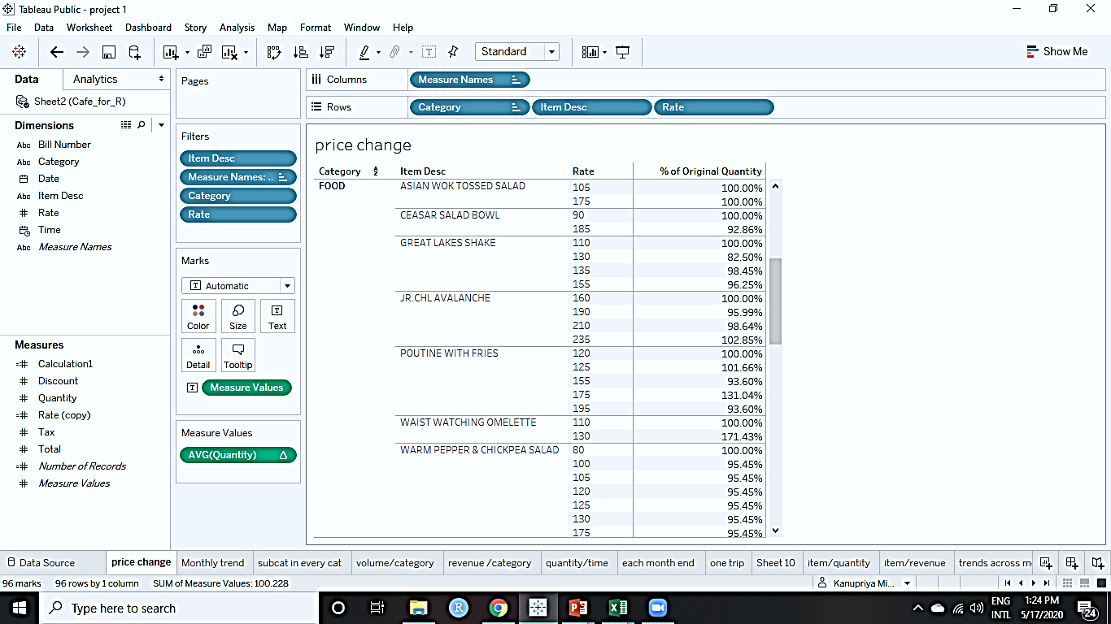
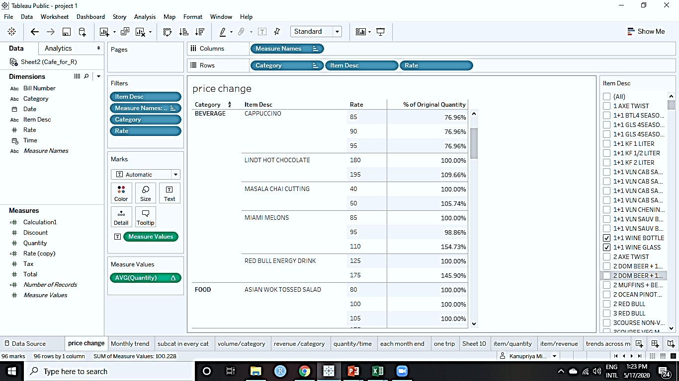
Liquor: A humongous increase in the price of liquor is visible. But we observe an unexplainable increase in the percentage sales after price hike. The sales have increased two folds in case of Stella Artois.
Food: even when theprices becoame two folds, we notice some food item’s sales weren’t affected negatively rather there was a positive trend in sales
Beverage: We observe that sales have increased in many cases with an increase in the rates of the Beverages.

Slide 19
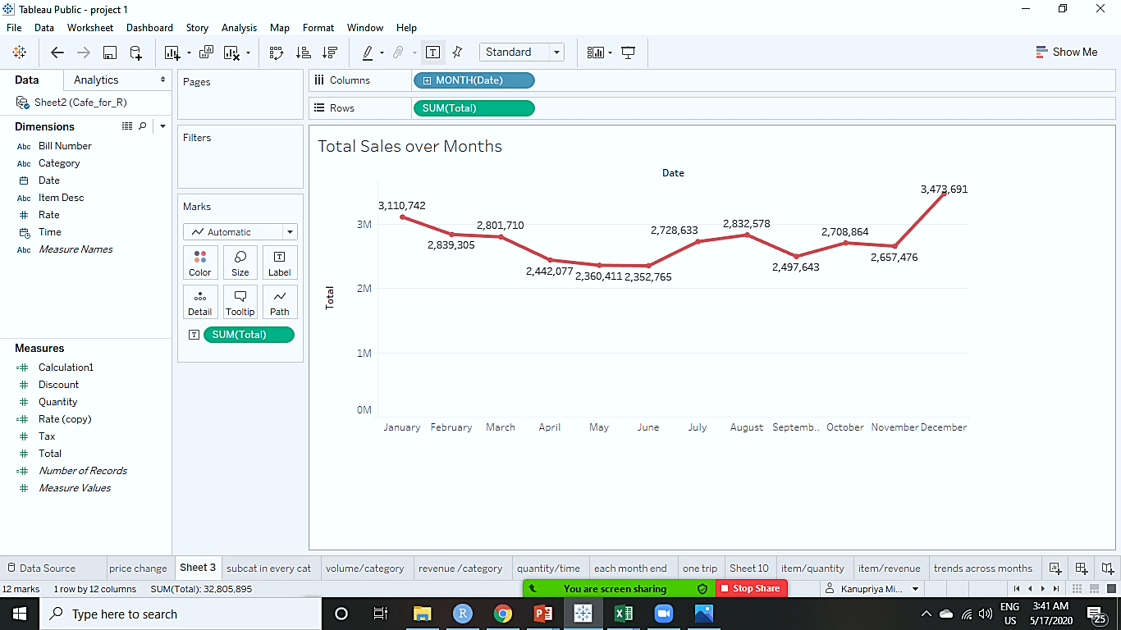
Monthly Trend Analysis The top 2 months for the Café in terms of revenue are: December with 34,73,691 INR and January contributing 31,10,742 INR The sales start declining from the month of January -> June and then there is a elevation in sales from June -> August and the end of December is the highest revenue generator because of new year celebrations Least revenue generating months: April, May, June (peak summer months)

Slide 20
Mix menu analysis and Combo offer Café Chain Analysis

Slide 21
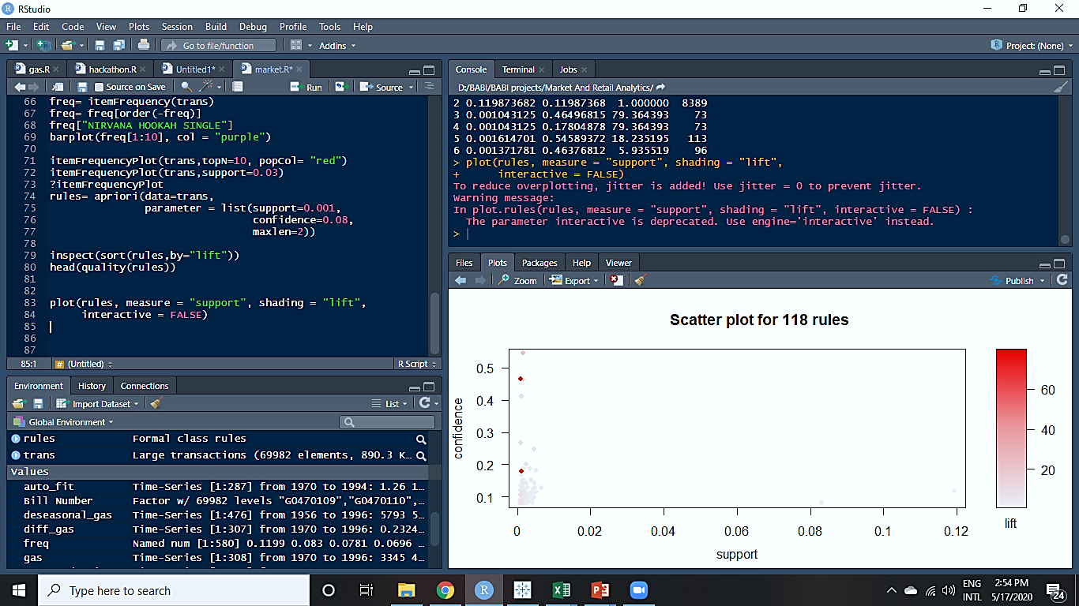
Combo offers – Tobacco, Food and Beverages are most selling categories for café. Therefore, we can make Combos from these Categories to buttress our sales.
Trip Segmentation- There are 39.3915% of solo trips (one item per transaction) in a year and Total of 69982 transactions. 54% of these solo transactions are from TOBACCO lovers. A strategic promotional initiative like combo offers can produce significant uplift to current revenue.
Analysis of the Association Rules via Scatter Plots

Slide 22
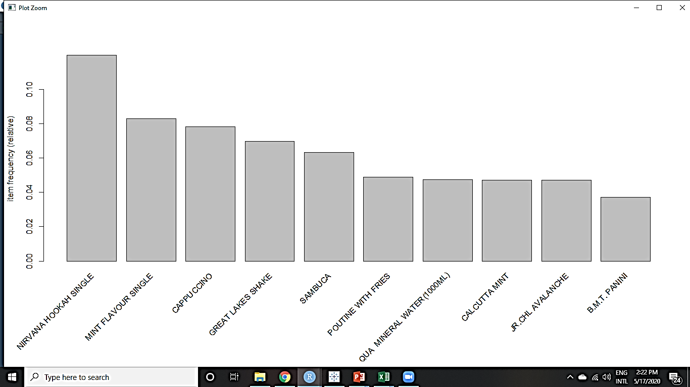
Most frequent items: Nirvana Hookah Single – 8389(constitutes 0.1198% of the total items bought.) Mint Flavour Single - 5812 Capuccino - 5468 Great Lakes Shake - 4871 Sambuca - 4423
most frequent items: NIRVANA HOOKAH SINGLE MINT FLAVOUR SINGLE CAPPUCCINO GREAT LAKES SHAKE 8389 5812 5468 4871 SAMBUCA (Other) 4423

Slide 23
Food Combos By scrutinizing the customers behavior in item purchases ,we have come up with combos to be added in our MENU in order to increase the quantity sold and thus, increase our revenue. Special offers can be showered on these combos to increase the sales and make it a lucrative deal for the customer.
ITEMS’ | COMBOS
ADD HERB ROAST CHICKEN with | LEMON INFUSED CHAR GRILLED VEG
ADD HAZELNUT FAVOUR with | CAFFE LATTE
ADD FRIES with | SATAY CHICKEN PANINI
FRENCH FREIS with | B.M.T PANINI
ADD FRIES with | COUNTRY ROAST CHICKEN PANINI
ADD HAZELNUT FAVOUR with | CAPPUCCINO
VANILLA ICECREAM with | GREAT LAKES SHAKE
BUN MASKA & CHAI with | MASALA CHAI CUTTING
BLACK CURRANT ICED TEA with | LEMON ICED TEA
KF DRAUGHT(1 LTR) with | KF DRAUGHT(1/2 LTR)
ADD FRIES with | KF DRAUGHT(1/2 LTR)

Slide 24
Recommendations For The Café
The Opening Hours and the closing hours should be reviewed on the basis of the Hourly Analysis done. This will optimize the salary expenditure of the Café.
The non-Tobacco item’s prices should be reviewed because the hike in some cases is causing reduction in sales.
39.39 % of total transaction is solo trips and mostly Tobacco .
There are numerous items in the menu which are purchased once in a blue moon. We need to Delist those items in order to lose our time and money over their preparation.
Combos should be added to the menu to make the deals lucrative for the customers. Combos on Food + Beverages should be created more so as to divert the sales from Tobacco to more healthier options.
Introduction of Combo offers will be game changer to move traffic towards food and Beverage and not only tobacco.
Implementation of loyalty program will prove efficacious, Café should start collecting customer details.

Slide 25
THANK YOU!

